Slide 1
NEWTON’S LAW OF COOLING
CO-2I
AMI 22224

Slide 2
GROUP 11 OF CO2I
Name of the Group Members involved in the Microproject
Qureshi Abdurrahman | 210451
Welder Umme Hafsa | 210452
Ansari Saad | 210453
Shaikh Azlan Ahmed | 210454
Qazi Mohd Oaish | 210455

Slide 3
INTRODUCTION
According to Newton’s law of cooling, the rate of loss of heat from a body is directly proportional to the difference in the temperature of the body and its surroundings.

Slide 4
01
HISTORY

Slide 5
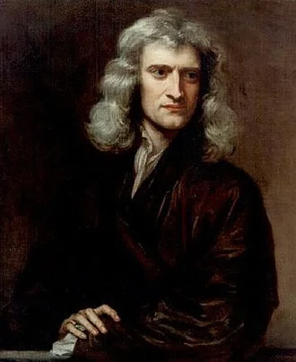
WHEN WAS THE LAW DEVELOPED?
Newton’s Law of Cooling was developed by Sir Isaac Newton in 1701. The law was not stated, as it is in the present form, initially.
Newton noted that the rate of temperature change of a body is proportional to the difference in temperatures between the body and its surroundings

Slide 6
02
EXPLAINATION

Slide 7
NEWTON’S LAW OF COOLING EXPLAINED
01
03
Newton’s law of cooling explains the rate at which an object/entity changes its temperature when it is exposed to radiation.
02
04
The formula of this law can be used to calculate how quickly a substance, at a particular temperature, would cool in a particular environment.
This change is almost proportional to the difference between the object’s temperature and its surroundings’ temperature, given that this difference is quite small.
It also allows us to determine how the rate of cooling of an object depends not only on the temperature difference between the substance and the surrounding but also on the constant of the substance.

Slide 8
03
FORMULA

Slide 9
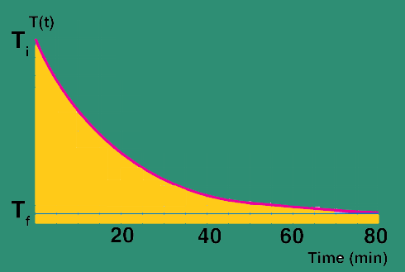
FORMULA
Newton’s Law of Cooling formula is expressed by,
T(t)=Ts+(T0–Ts)e^{−kt}
Where,
T(t) – object’s temperature at time ‘t’ (a.k.a Tf),
Ts – surrounding temperature,
T0 – the initial temperature of the body,
t – time,
k – constant of proportionality

Slide 10
04
DERIVATION

Slide 11
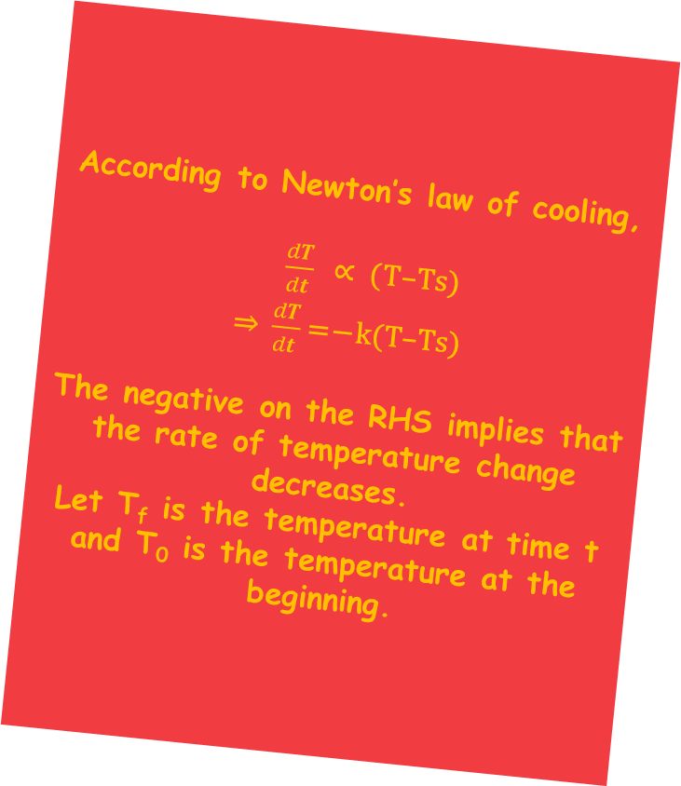
DERIVATION PART I
According to Newton’s law of cooling, $\frac{dT}{dt}$ ∝ (T–Ts) ⇒ $\frac{dT}{dt}$=−k(T–Ts) The negative on the RHS implies that the rate of temperature change decreases. Let T_{f} is the temperature at time t and T₀ is the temperature at the beginning.

Slide 12
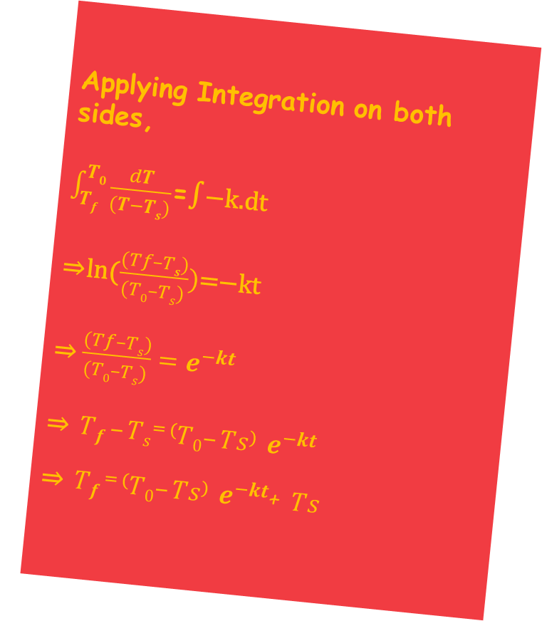
DERIVATION PART II
Applying Integration on both sides, $\int_{Tf}^{T0}{\frac{dT}{(T−Ts)}}$=∫−k.dt ⇒ln($\frac{(Tf–Ts)}{(T0–Ts)})$=−kt ⇒ $\frac{(Tf–Ts)}{(T0–Ts)}=e^{−kt}$ ⇒ $Tf –Ts$⁼ ⁽$T0–Ts$⁾ $e^{−kt}$ ⇒ $Tf$⁼ ⁽$T0–Ts$⁾ $e^{−kt}$+ $Ts$

Slide 13
05
LIMITATIONS & APPLICATION

Slide 14
Limitations
Applications
The difference in temperatures between the surroundings and the object must be small,
The loss of heat should be via radiation only,
The temperature of the surroundings must remain constant during the cooling of the object.
Used to predict how long it will take for a hot object to cool down at a constant temperature.
It also helps to indicate the death time given by the probable body temperature at the death time and the current body temperature.

Slide 15
SOLVED EXAMPLES
06

Slide 16
PROBLEMS
Question 1
Question 2
Question 3
A body with a temperature of 40º C is kept in the surroundings with a constant temperature of 20º C. If the temperature falls to 35º C in 10 minutes, find out how much excess time it will take for the body to attain the temperature of 30º C.
Water in a vessel is heated to 80º C for 10 minutes. How much would the temperature be, if k = 0.056 per minute and the surrounding temperature is 25º C?
Water is heated to 80ºC for 10 min. How much would be the temperature if k = 0.56 per min and the surrounding temperature is 25ºC?

Slide 17
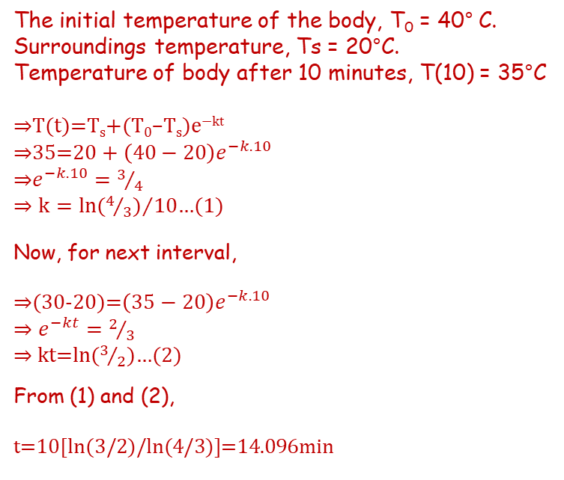
SOLUTION 1
The initial temperature of the body, T₀ = 40° C.
Surroundings temperature, Ts = 20°C.
Temperature of body after 10 minutes, T(10) = 35°C
⇒T(t)=T_{s}+(T₀–T_{s})e^{−kt}
⇒35=$20+\left(40−20\right)e^{−k.10}$
⇒$e^{−k.10}=3/4$
⇒ $k={ln⁡(4/3)}/{10}$…(1)
^{Now, for next interval,}
⇒(30-20)=$\left(35−20\right)e^{−k.10}$
⇒ $e^{−kt}=2/3$
⇒ kt=ln($3/2$)…(2)
^{From (1) and (2),}
t=10[ln(3/2)/ln(4/3)]=14.096min

Slide 18
SOLUTION 2
^{Given,}
^{Ts = 30° C}
^{T}0 ^{= 100° C}
^{t = 10 min}
^{k = 0.056}
Now, substituting the above data in Newton’s law of cooling formula,
⇒T(t)=T_{s}+(T₀–T_{s})e^{−kt}
⇒T(10)=30+(100–30)e^{−0.056*10}
⇒T(10)=30+70*0.57
^{∴T(10)=69.9°C}
∴ Temperature cools down from 100°C to 69.9°C after 10 minutes.

Slide 19
SOLUTION 3
^{Given,}
^{Ts = 25° C}
^{T}0 ^{= 80° C}
^{t = 10 min}
^{k = 0.056}
Now, substituting the above data in Newton’s law of cooling formula,
⇒T(t)=T_{s}+(T₀–T_{s})e^{−kt}
⇒T(10)=25+(80–25)e^{−0.56*10}
⇒T(10)=25+[55*0.57]
^{∴T(10)=56.35°C}
∴ Temperature cools down from 80°C to 56.35°C after 10 minutes.

Slide 20
07
FAQs

Slide 21
REVIEW THE CONCEPTS
What does the rate of cooling of an object depend on?
Why is Newton’s law of cooling important?
The rate of cooling of a body is dependent of the nature of the surface of the body, the area of the body, the excess of temperature of the body above that of the surroundings and also on the temperature of the surroundings.
Newton’s law of cooling explains how fast a hot object can cool down. For example, the rate of cooling of hot water in pipes can be explained by Newton’s law of cooling.

Slide 22
08
REPORT

Slide 23
REFERENCE
ProtonsTalk
https://protonstalk.com/thermal-properties-of-matter/newtons-law-of-cooling/
✓
BYJU’S
https://byjus.com/jee/newtons-law-of-cooling/
✓
Carolina
https://www.carolina.com/teacher-resources/Interactive/newtons-law-of-cooling/tr36401.tr
✓

Slide 24
ACTUAL METHODOLOGY FOLLOWED
9TH GRADE
Teacher gave us the project project and divided the groups. We discussed about the topic and searched for the information and divided the word accordingly. The report was made

Slide 25
Hence we learned about Newton’s Law of Cooling, It’s Formula and how it was Derived. And how it is used to determine the temperature of an object after a given time when it loses heat to the surroundings.
-COURSE OUTCOME
9TH GRADE

Slide 26
THANK YOU

